Slide 1
Topic: Work place emotions
Dr. C. Vijaya Banu
Professor , School of Management
SASTRA Deemed University, Thanjavur – 613 401
vijayabanu@mba.sastra.edu

Slide 2
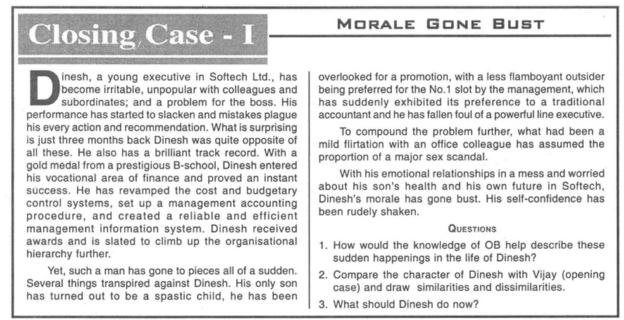

Slide 3
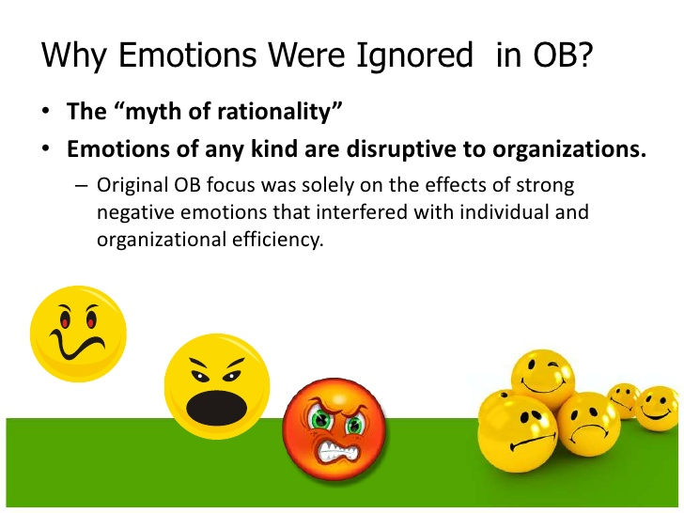

Slide 4
What are Emotions?
Ask anyone how they feel, and you will get an array of emotional adjectives by way of response (e.g. I feel happy, I feel excited, I’m upset)
Emotions are conscious emotional states accompanied by bodily arousal. They are brief and directed at specific events or people
Similar to feeling states, they are conscious (i.e. we know we are experiencing them), they are accompanied by bodily arousal (e.g. the physical feeling of tenseness or excitement) and they make themselves observable through expression and behaviour (Tice 2009)

Slide 5
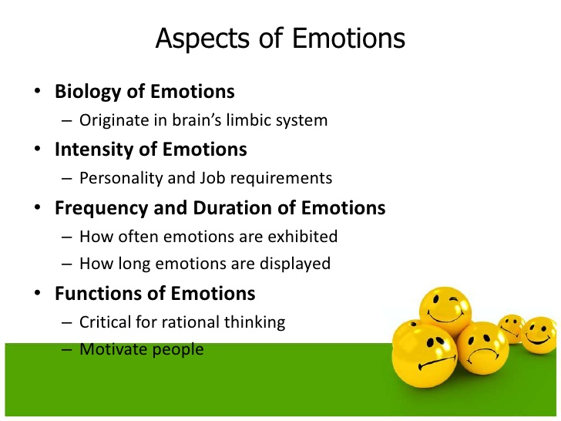

Slide 6
Are feelings, emotions and mood the same?
Frequently, we use the terms ‘feelings’, ‘emotions’ and ‘moods’ interchangeably
Feelings, emotions and moods all stem from affect
Affect is an umbrella term that encompasses a broad range of feelings, including ‘feeling states’, which are in-the-moment, short-term emotional experiences, and ‘feeling traits’, which are more stable tendencies to feel and act in certain ways (Barsade and Gibson 2007)
Mood refers to an affective response that lasts much longer than an emotion (Tice 2009)

Slide 7
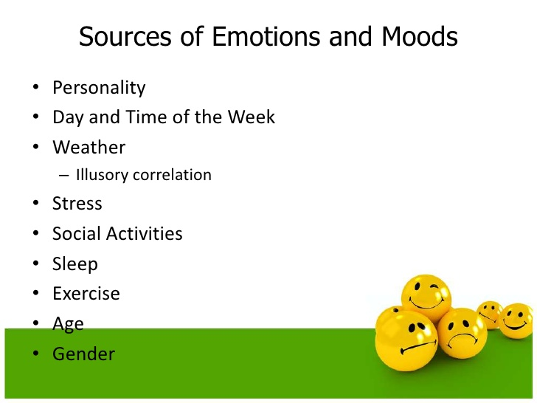

Slide 8
The Circumplex Model of Core Affect
Core affect refers to momentary, elementary feelings of pleasure or displeasure and of activation or deactivation
Russell and Barrett (1999) provide two central propositions of core affect
An individual has the experience of a momentary, elementary feeling of pleasure or displeasure, and then attributes this to a cause
Core affect has a two-dimensional structure
Valence of an emotion – labelling our emotions as either positive or negative
The level of activation - the extent to which an emotion energises us or prompts us to take action

Slide 9
The Two-Dimensional Structure of Core Affect
Source: Feldman Barrett, L., and Russell, J.A. (1998). Independence and bipolarity in the structure of current affect. Journal of Personality and Social Psychology, 74(4), 967-984.

Slide 10
Emotions in the workplace
Emotions have been shown to play a role in performance, decision-making, creativity, group dynamics and individual behaviours
For example, Lyubomirsky, King, and Diener (2005) demonstrated that an individual’s tendency to experience positive emotions and moods is associated with increases in a number of performance indicators
When considering the role of emotions in the workplace, it is also important to distinguish between the expression and experience of emotions at work

Slide 11
Why are emotions are beneficial in the workplace?
According to the circumplex model, positive emotions will only lead to higher effort when these emotions are in the active quadrant of the circumplex
This raises an interesting question about whether managers really want satisfied workers as satisfaction is a passive emotion
Emotions can also help us to learn. By providing feedback, emotions may stimulate retrospective appraisal of actions
Emotions stimulate counterfactual thinking which is a human tendency to create possible alternatives to events that already occurred, e.g. asking ‘What if..” or ‘If only I had…”

Slide 12
Managing emotions in the workplacee
Emotion regulation refers to the set of processes whereby people manage their emotional states, including specific emotions such as anger or sadness, moods such as depression and euphoria, general stress responses and rapid affective reactions that may or may not be consciously experienced
Basic components of emotion regulation include recognition and understanding of one’s own emotions, managing these emotions by inducing, modulating or preventing them, and using emotions for action and goal attainment (Pekrun 2006)
Individuals must be aware of their current emotional state and the possible consequences an emotion has, both for themselves and for others (Niedenthal et al. 2006)
Emotion regulation has links to the concept of emotional intelligence (EI)
Salovey, Hsee, and Mayer (1993) introduce EI as referring to three inter-related skills or abilities:
accurate appraisal of mood and expression of emotion by oneself and others,
adaptive regulation of emotion in self and others,
utilizing emotions (e.g. in problem solving)

Slide 13
Managing emotions in the workplace
Goleman’s (1995) approach to emotional intelligence assesses 20 competencies, subsumed under four clusters:
Self-awareness
Self-management
Social awareness
Social skills

Slide 15
Emotional Intelligence

Slide 16
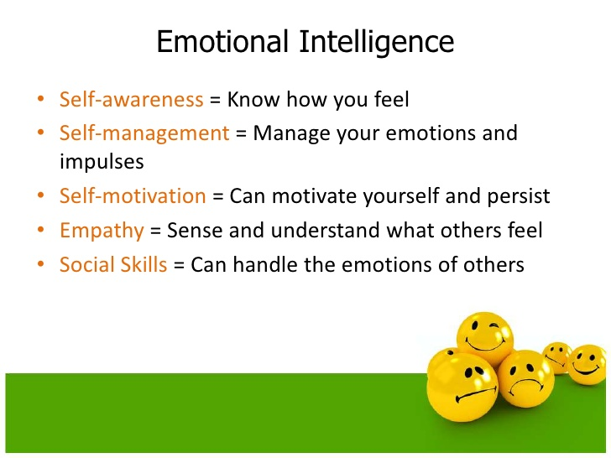

Slide 17
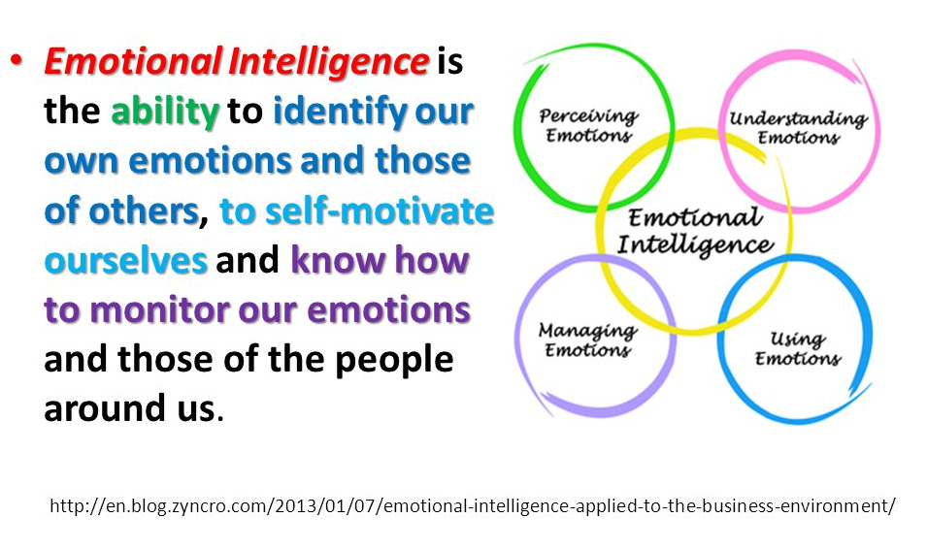
Emotional Intelligence

Slide 18
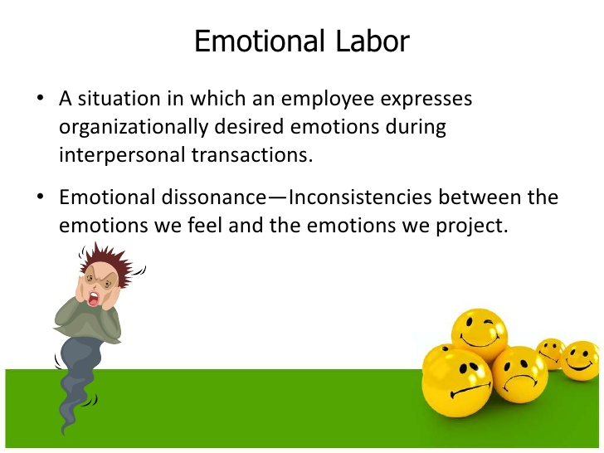

Slide 19
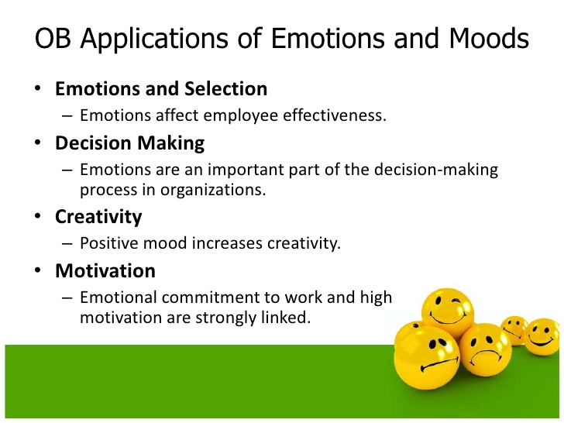

Slide 20
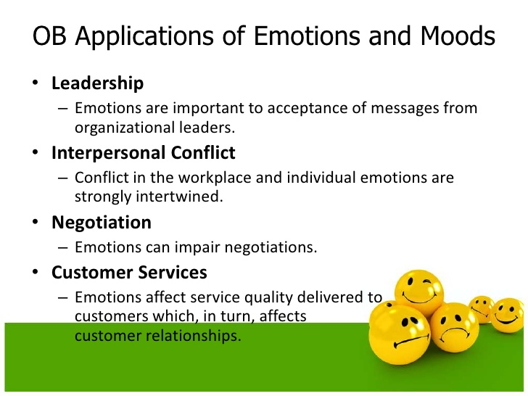

Slide 21
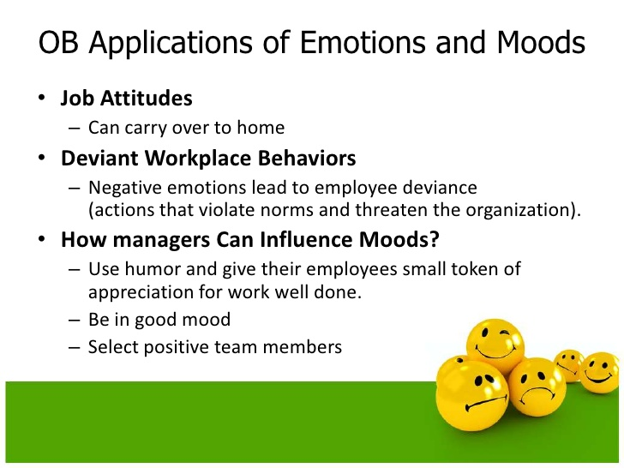

Slide 22
references
https://www.macmillanihe.com/resources/CW%20resources%20(by%20Author)/C/Cross%20and%20Carbery/Teaching%20Resources/slides/OB%20Chapter%206.pptx

